Slide 1
Orientation Video 23-24 school year
Welcome to the Remote K-8 School
216-838-7250
Our goal is to provide an equitable and individualized learning environment so that we can develop well-rounded, confident, and responsible students who strive to reach their full potential.

Slide 2
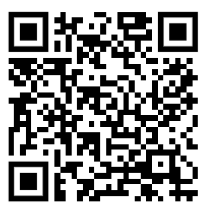
Important Contacts
Principal: Chris Wyland
(216) 838-7250
Christopher.wyland@clevelandmetroschols.org
Assistant Principal: Princess Shepard
(216)838-7250
princess.shepard@clevelandmetroschools.org
John Morris: Say Yes
jmorris@sayyescleveland.org
Secretary: Shaquita Jackson
shaquita.jackson@clevelandmetroschools.org
(216) 838-7250
Website - https://www.clevelandmetroschools.org/RemoteSchoolK8
Facebook/Instagram - @CMSDRemoteK8

Slide 3
Good Candidates for our School
Students who excel at independent learning.
Self-directed and motivated.
Students who can independently engage with learning technology.
Proficient in navigating a digital learning space and multiple learning platforms and applications.
Students who can manage their own time.
Maintain schedules.
Regulate tasks and prioritize their time.
Organize their physical and mental workspace.

Slide 4
School Day
Instructional Day – 8:00 AM to 2:30 PM
Students will have a formal class schedule that they must follow.
Monday, Tuesday, Thursday, Friday: Synchronous learning (live classes) for up to 175 minutes per day; asynchronous learning (independent, one-on-one, or small group work) for 150 minutes per day.
Wednesday: Class Meetings – REQUIRED, family engagement, independent learning, tutoring, office hours, small group instruction, etc.
Students must be online, completing learning related tasks for 6 hours each school day.

Slide 5
Attendance Requirements
Students are required to attend school 180 days per year. Regular attendance is vital for student success. ALL live classes must be attended each day.
Parent/Guardians are required to call the school (838-7250) in the morning, by 10:00am, if their child will be absent or tardy.
For technology related issues, the parent/guardian must contact the school to inform of the issue AND must contact the HelpDesk at 216-838-0440 for technical support. All work missed due to technical issues must be completed by the student.

Slide 6
Engagement Expectations
Students MUST be logged in and attending class and completing work for 6 hours each school day.
Cameras must be on at all times. If the camera is not able to be on the following expectations are in place:
Parent/Guardians must communicate with the classroom teacher the reasons.
Permissible reasons include, but are not limited to, device issues, medical and mental health reasons, and special education accommodations.

Slide 7
Attendance and Engagement
Per the Ohio Department of Education, in order to show proof of attendance and engagement in a Remote School, student must both attend live classes and log-in and complete assignments in Clever/Schoology each day.
In accordance with Ohio Revised Code 3314.261(A-F), each internet or computer-based school shall develop a policy regarding failure to participate in instructional activities. The policy shall state that a student shall become subject to certain consequences, including disenrollment from the school. Therefore, failure to meet attendance and engagement expectations will result in consequences that may require a transition back to a brick-and-mortar school setting or an alternative setting, such as the Virtual Academy.

Slide 8
Technology
Clever –
Signal Sign-On
Access to Schoology, Teacher Pages, Learning Applications
Students can use their username and password to login to the Clever Learning Portal
Schoology
All course content is kept
Must use a school provided device
On site IT support, 8:30-3:30, each school day.

Slide 9
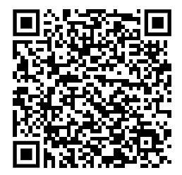
Technology
School devices are for school related work and are the responsibility of the students and parent/guardian.
Please review the District Digital Guidelines around devices with your student.
Set up ground rules for computer usage. These should include:
Use the device for school related work only.
Take the device each night and ensure that it is plugged in.
Keep the computer on a stable surface, such as a desk and not a bed.
Do not walk around with the computer.
Keep food and drink away from the computer.
Keep the computer clean.

Slide 10
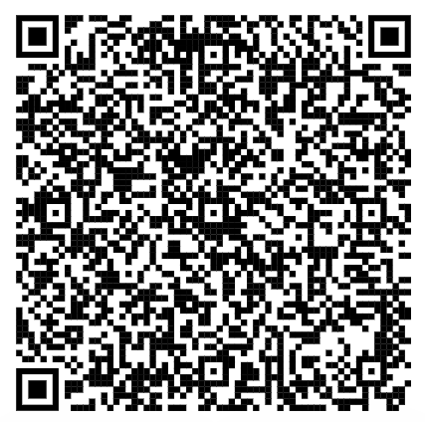
Support Services
A Say Yes Family Support Specialist is assigned to every CMSD school to connect students and families to free support services and resources in our community​
Mental and physical health services ​​
Free legal services​​
Afterschool programming ​
John Morris
Say Yes Cleveland
CMSD Remote K-8 School
216-894-9488
jmorris@sayyescleveland.org
Family Support Request Form

